Slide 1

Referendums

Slide 2
Aim
To understand the process of changing Australia’s constitution through a referendum.
Explain the importance of the 1967 Referendum in Australia
To define the terms ‘referendum’ and ‘discrimination’

Slide 3
What is a referendum?
https://www.abc.net.au/btn/classroom/constitution/10529046
Record 3 words which could be used to describe ‘referendum’.
Using these words, create your own definition of a referendum and write it in your book.

Slide 4
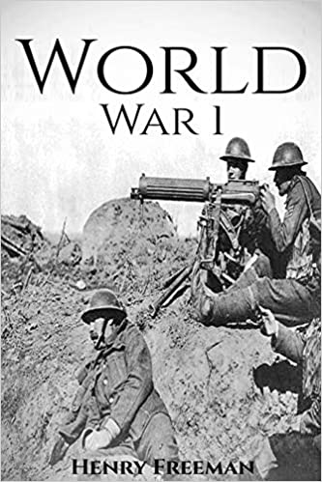

Why is it important to be able to change the constitution?
How long ago was the Constitution written?
Think of some major changes that have happened to society over the past 100 years.
Since Australia became a federation in 1901, 19 referendums have proposed 44 changes to the constitution.
Only 8 changes have been agreed to!

Slide 5

Referendums
Times have changed since the Constitution was written in 1901
Therefore, it’s important that it can be changed through a referendum
It is important that all citizens have a say in the changes
Why is it important for citizens to have a say?

Slide 6
The steps to changing the Constitution
There is a section in the Constitution which outlines how a referendum should be carried out
2. Members of the HOR and Senate form committees- either yes or no.
3. The Governor General issues a ‘writ’, a formal written order, to set the dates for the referendum (on a Saturday).
4. Case committees prepare a case for voting ‘yes’ or ‘no’. They send out a formal statement to every voter in Australia.
1. A bill must be passed by BOTH houses of Federal Parliament
5. Voters must then vote either ‘yes’ or ‘no’ to the proposed changes. A double majority needs to be achieved for the change to be made. Then the Governor General must approve.

Slide 7
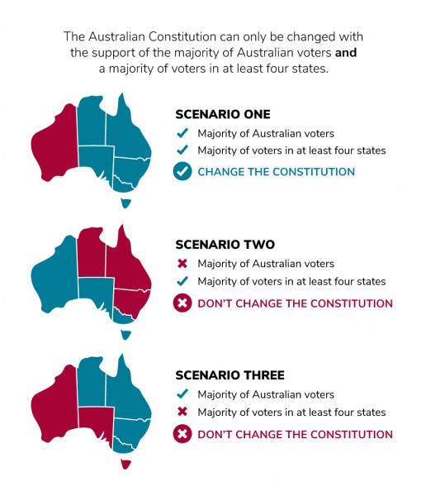
“Double Majority”

Slide 8
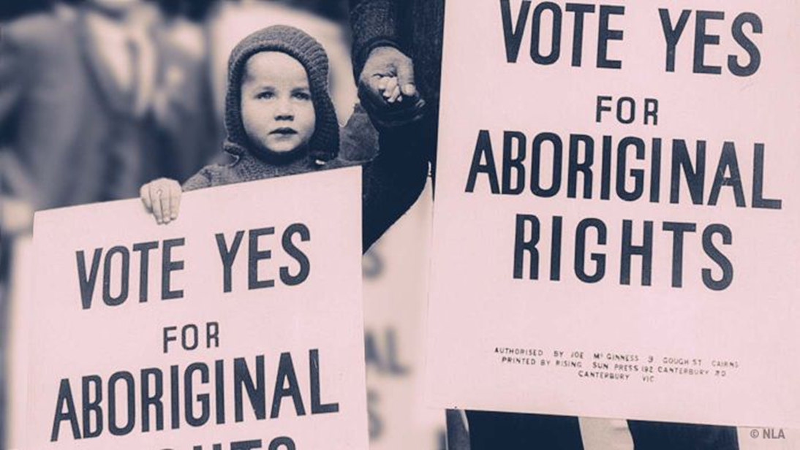
1967 Referendum- Australia
https://www.abc.net.au/btn/classroom/1967-referendum/10523010
Most successful referendum in Australia’s history
27th of May now marks the start of Australia’s National Reconciliation Week, a time when Australia celebrates the relationship between Aboriginal and Torres Strait Islander peoples and other Australians.

Slide 9
Activity
Complete the statements below by matching the end of the sentence to its beginning and writing it in your book.
A referendum is the only way the Australian Constitution…
To change the Constitution, a proposal (Bill)….
During a referendum, all citizens are required to vote…
To be successful, a referendum needs….
A double majority
Must first be approved by parliament
Can be changed
‘yes’ or ‘no’ to the proposed change

Slide 10
Activity: Classroom Referendum
https://peo.gov.au/teach-our-parliament/classroom-activities/democratic-ideas/hold-a-referendum/

Slide 11
What changes do you propose?
Write down on your sticky note:
  One change that you propose for this school
  One change that you propose for Hedland (both Port & South)
*Do not write anything inappropriate. It will be taken down.

Slide 12
Class Referendum
Proposed change:
We should make school days one hour longer. Students will not receive homework.

Slide 13

Committees
Proposed change:
We should make school days one hour longer. Students will not receive homework.
Divide class in half.

Slide 14
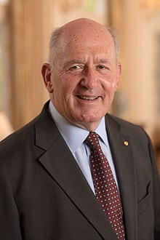
Governor General
Proposed change:
We should make school days one hour longer. Students will not receive homework.
Governor General- to write a formal ‘writ’ to set the dates of the referendum.

Slide 15
Prepare your cases
Be ready to share your answers with the class.

Slide 16

Time to vote!

Slide 17
Extension: Plebiscite
Plebiscite
In Australia, a plebiscite (also known as an advisory referendum) is used to decide a national question that does not affect the Constitution. It can be used to test whether the government has enough public support to go ahead with a proposed action. Unlike a referendum, the decision reached in a plebiscite does not have any legal force.
Australia has held 4 national plebiscites, including the same-sex marriage plebiscite in 2017.

